Slide 1
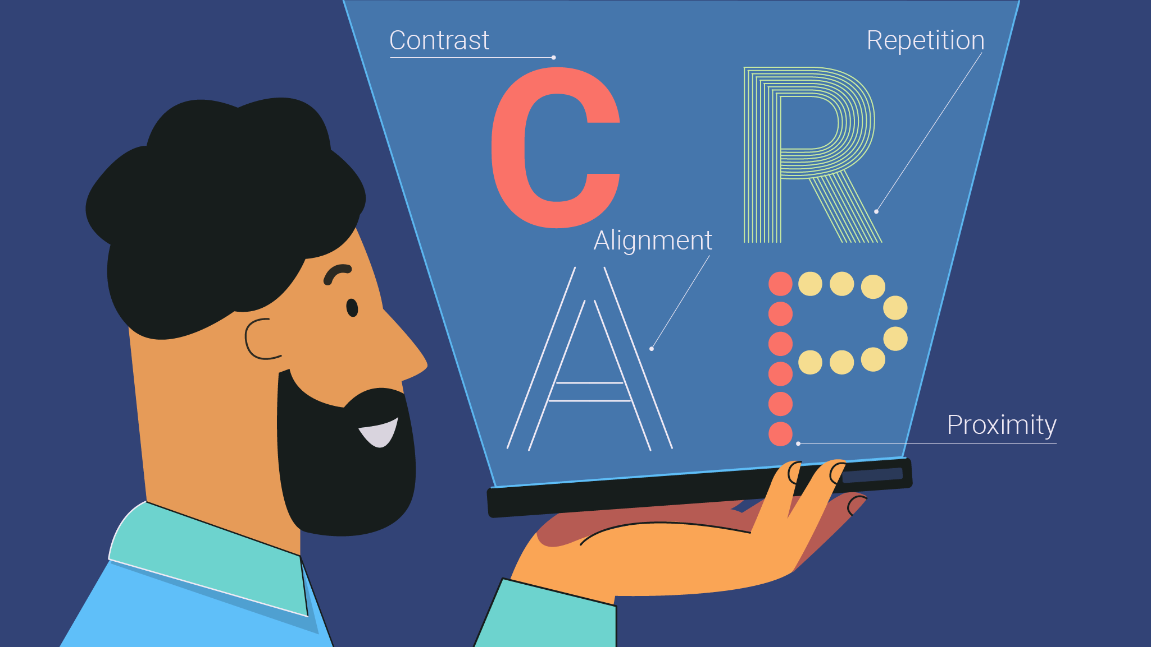

WEB DESIGN
W1-S2 – Design Principles

Slide 2

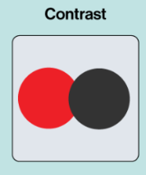
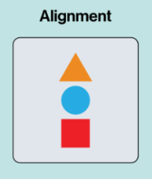
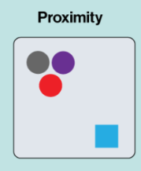
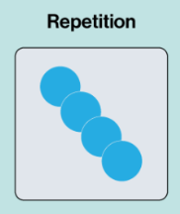
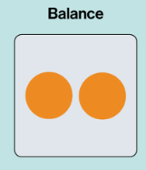
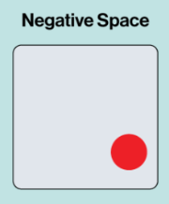
EXPLAIN
6 Design principles
20 MIN

Slide 3
Contrast
Not related elements are graphically different
A visual must contain 1 or many elements in contrast, to guide the reader eyes into the page
LIBRARY
CLUB
Q1 - Does the design use enough contrast to differentiate elements?
Q2 - Do the elements with high contrast stand out as intended?
LIBRARY
CLUB
WHY READING IS SO IMPORTANT ?
Reading and writing work in similar ways. Reading improves your writing style and flow. Writers learn to perfect their craft by taking inspiration from other writers. It’s impossible to be a good writer if you don’t read. Acclaimed author Stephen King is said to carry a book with him wherever he goes. He even reads while eating.
WHY READING IS SO IMPORTANT ?
Reading and writing work in similar ways. Reading improves your writing style and flow. Writers learn to perfect their craft by taking inspiration from other writers. It’s impossible to be a good writer if you don’t read. Acclaimed author Stephen King is said to carry a book with him wherever he goes. He even reads while eating.

Slide 4
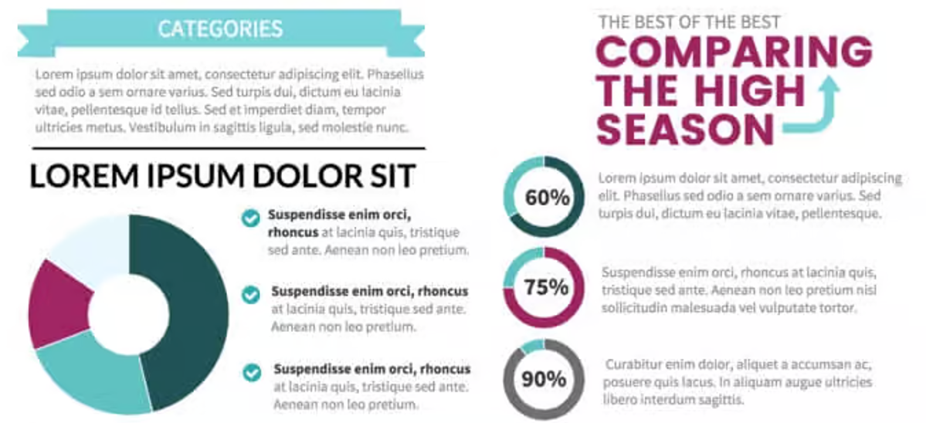
Alignment
Alignment ensure elements are arranged in a visually appealing and logical way.
Nothing should be placed on the page arbitrarily !
An invisible line connect aligned elements !
Q1- Are text, images, and other elements aligned properly to create order and cohesiveness?
Q2 - Are there any elements that feel "out of place"?

Slide 5

Proximity
Proximity refers to the closeness of related elements.
Things that are related should be close to each other
Q1- Are headlines, body text, and images that belong together placed near each other?
Q2 - Are elements spaced too far apart or too close together?

Slide 6
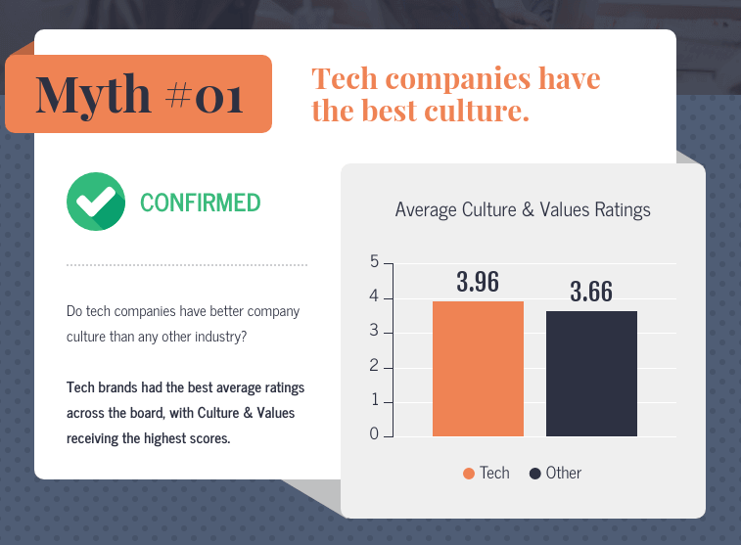
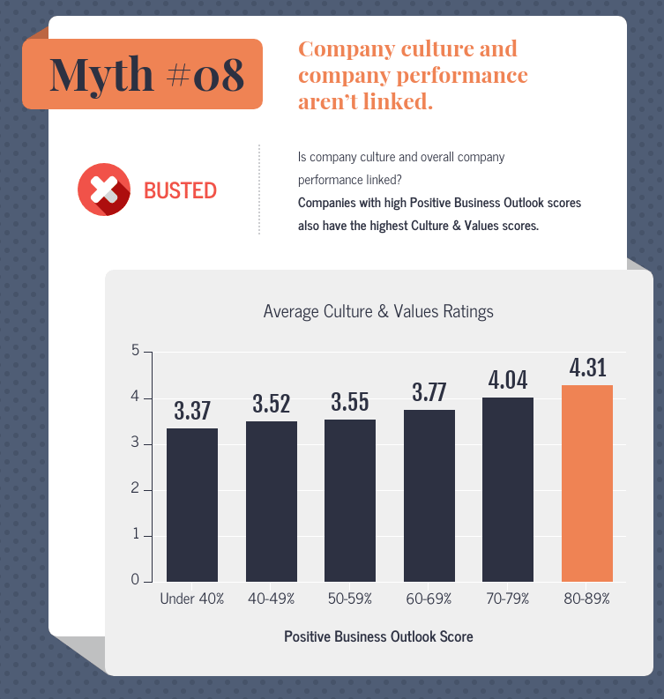
Repetition
Repeat the style of some elements to unify and link them together
It can be applied to elements : fonts, colors, shapes, or layouts
Repetition makes a design more cohesive
Q1- Are colors, fonts, or shapes used consistently across the design?
Q2 - Does the repetition feel intentional and effective?

Slide 7
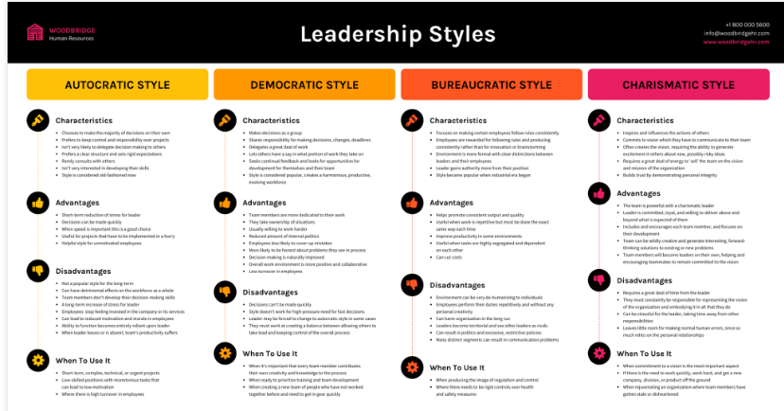
Balance
Balance refers to the distribution of visual weight in a design
It can be symmetrical or asymmetrical (more dynamic but still visually balanced)
Proper balance ensures a sense of stability and harmony in the design
Q1- Is the design the same on both sides or does one side have more weight than the other?
Q2 - Does the design feel even and comfortable to look at, or does it feel lopsided and uneven?

Slide 8
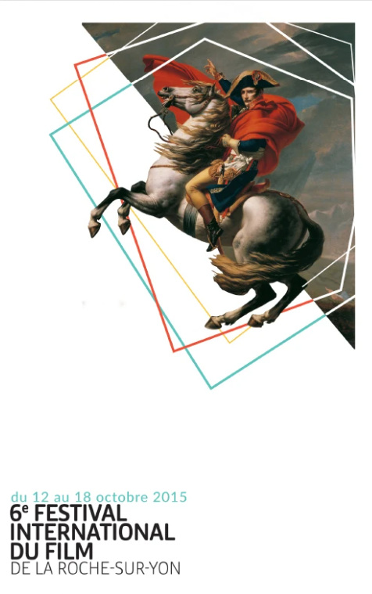
White Space
White space is the empty area between design elements.
It makes it easier for the users to understand the content and the relationships between the elements
Q1- Does the design have enough white space to avoid overcrowding, or does it feel empty?
Q2 - Is the white space used to guide the viewer’s eye effectively?

Slide 9

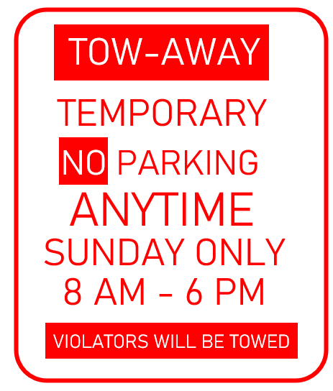
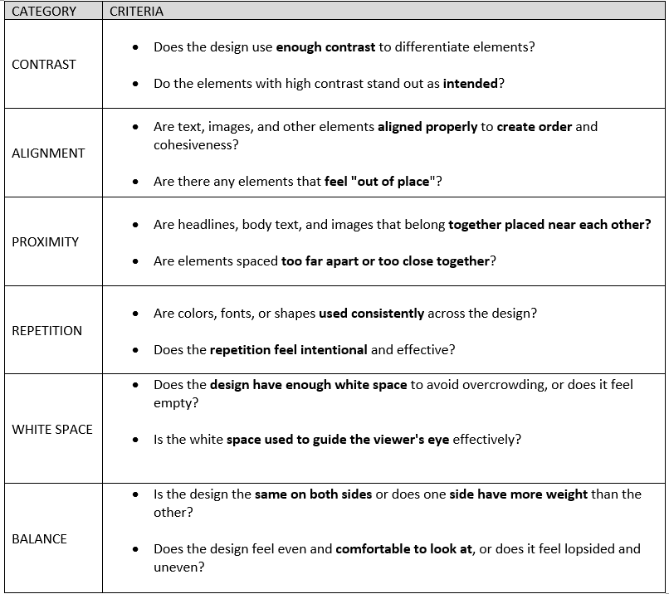
GROUP WORK
Group Work
70 MIN
See instruction in the document
1- Analyze 3 graphic designs regarding the principles we leant
2- Complete the evaluation sheet
3- Presentation to the class
Your graphical analysis
Your proposition of improvements (if any)

